Slide 1
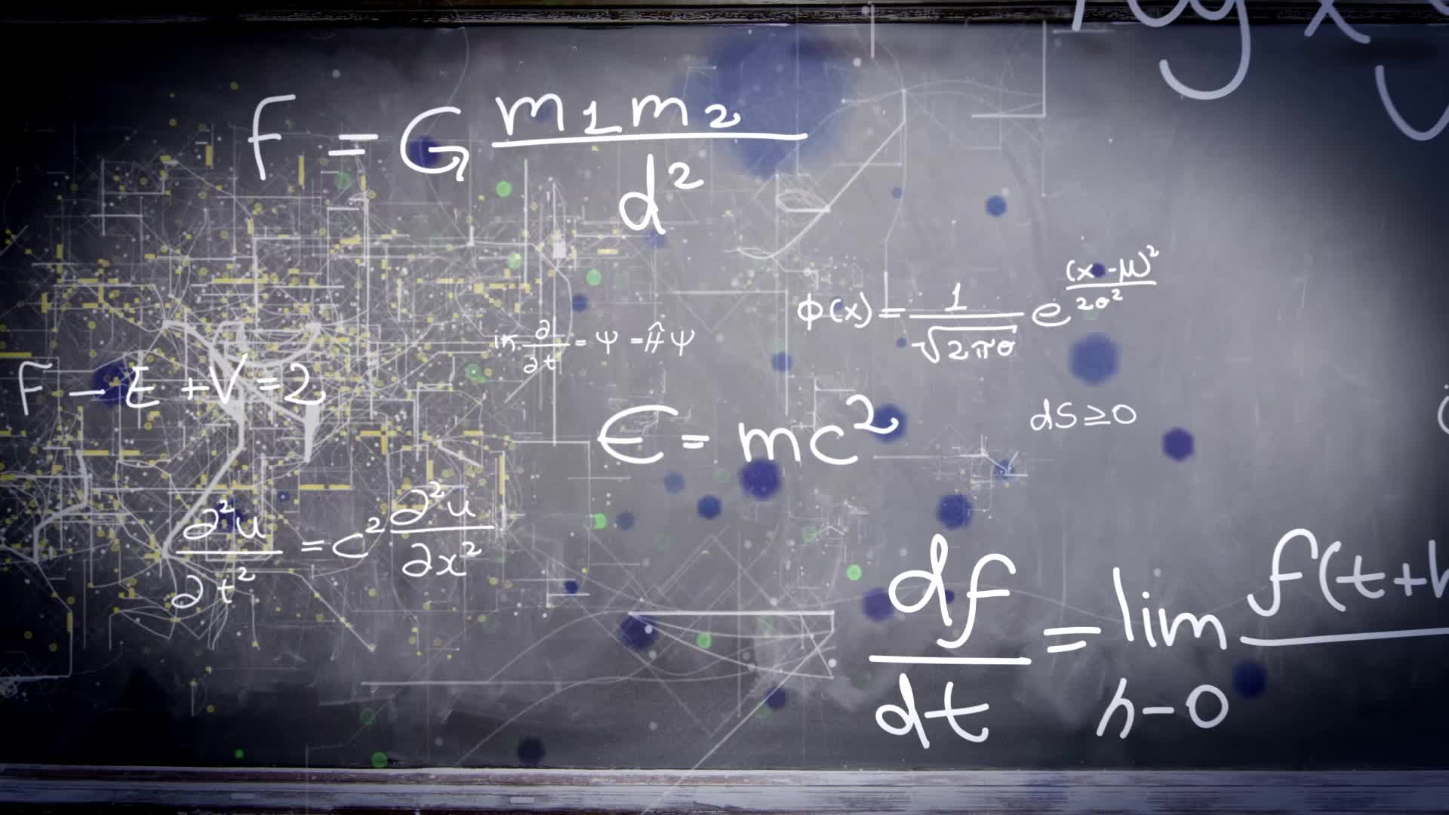
Chapter 3.9:
Differentials
HONORS CALCULUS/CALCULUS

Slide 2
Definition of Differentials
Let $y=f(x)$ represent a function that is differentiable on an open interval containing $x$. The differential of x (denoted by $dx$) is any nonzero real number. The differential of y (denoted by $dy$) is
$$dy=f^{′}\left(x\right)dx.$$
In many applications, the differential of $y$ can be used as an approximation of the change in $y$. That is
$∆y≈dy$ or $∆y≈f^{′}\left(x\right)dx$

Slide 3
Ex. 1) Let $y=x^{2}$. Find $dy$ when $x=1$ and $dy=0.01$. Compare this value with $∆y$ for $x=1$ and $∆x=0.01$.

Slide 4
Differential Formulas
Let $u$ and $v$ be differentiable functions of $x$.
Constant Multiple | $$d\left[cu\right]=cdu$$
Sum or Difference | $$d\left[u±v\right]=du±dv$$
Product | $$d\left[uv\right]=udv+vdu$$
Quotient | $$d\left[\frac{u}{v}\right]=\frac{vdu−udv}{v^{2}}$$

Slide 5
Ex.2) Find the Differential.
Function | Derivative | Differential
$$y=x^{2}$$
$$y=2sinx$$
$$y=xcosx$$
$$y=\frac{1}{x}$$

Slide 6
Ex. 4) $y={\left(x^{2}+1\right)}^{\frac{1}{2}}$
Ex. 3) $y=sin3x$

